Slide 1
CYWG (CyberInfrastructure Working Group)
October 2014
iDigBio Data Ingestion
Dan Stoner
Advanced Computing and Information Systems Laboratory (ACIS)
University of Florida
dstoner@acis.ufl.edu
@thatlinuxbox

Slide 2

Over 300 Data Providers...

Slide 3


Slide 4
Data Ingestion Progress
November 2013 -
4.2 million specimen records
0.9 million media records
October 2014 -
23.9 million specimen records
3.4 million media records

Slide 5
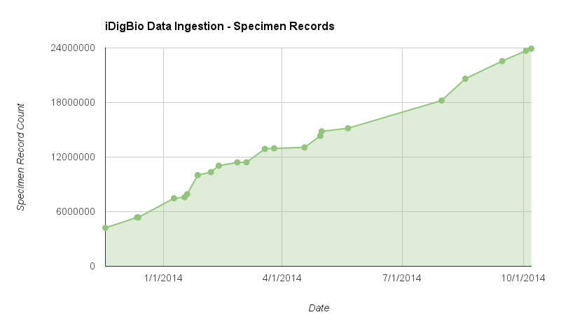

Slide 6
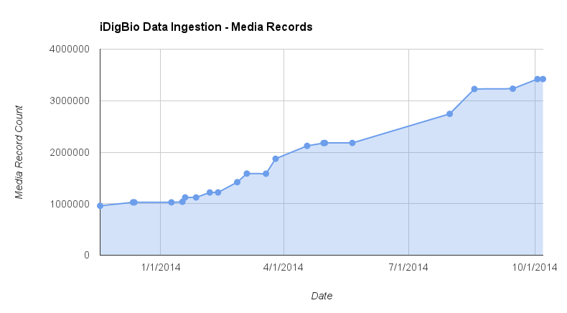

Slide 7
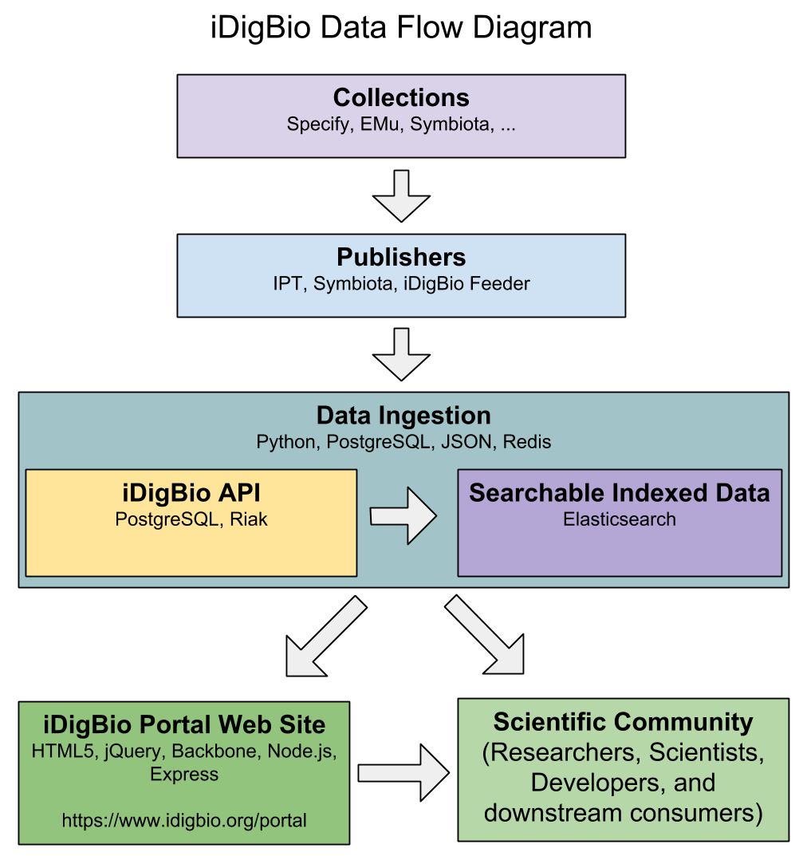

Slide 8
Three types of data publishing technologies currently being consumed by iDigBio:
GBIF Integrated Publishing Toolkit (IPT) - a Java tool used to publish and share biodiversity datasets
http://www.gbif.org/ipt/
Symbiota – web-based collection management software
http://symbiota.org/
iDigBio RSS Feeder – data sharing service for providers who do not run infrastructure

Slide 9
Dataset Formats Consumable by iDigBio
IPT – DwC-A
Symbiota portals – DwC-A
iDigBio Feeder – DwC-A, CSV, …
If you can export specimen data from your system / database / spreadsheet into DwC-A (or even CSV), then you can share data with iDigBio.
iDigBio RSS Feeder facilitates the sharing of over 1.5 million specimen records and 200 thousand media records from providers who do not need to run “servers”.

Slide 10
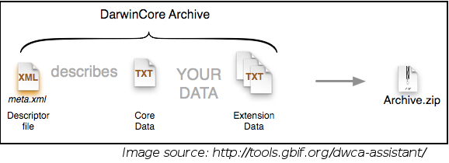
Darwin Core Archive / DwC-A
http://rs.tdwg.org/dwc/terms/guides/text/
A Darwin Core Archive is a zip file that includes metadata about the dataset, the data itself, and any optional extension data.

Slide 11
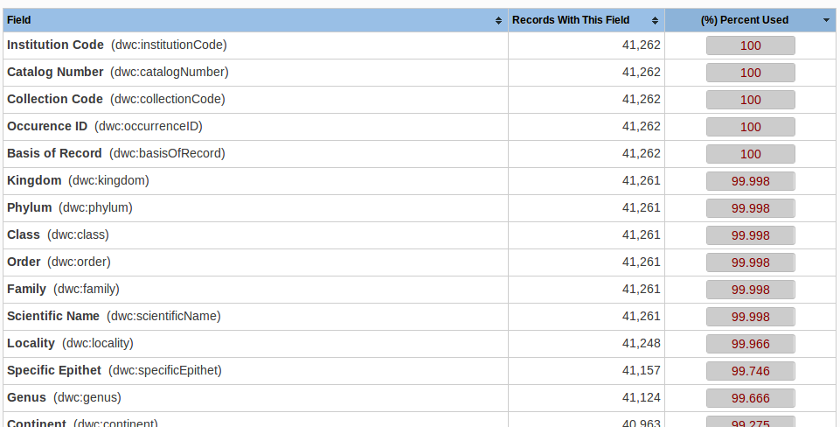
Specimen Data – Darwin Core Standard
http://rs.tdwg.org/dwc/terms/

Slide 12
Recommended minimum Darwin Core fields for iDigBio Ingestion:
Record ID
Scientific Name
Occurrence ID
Event Date
Collector Name
Locality Data
Barcode, catalog number, accession id or collection number
Paleo specimens should also include geological context

Slide 13
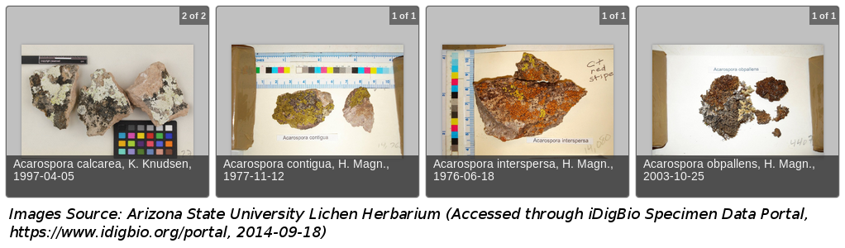
Media Data – Audubon Core / AC
http://terms.tdwg.org/wiki/Audubon_Core_Term_List
GBIF has a nice write-up on the benefits of AC over dwc:associatedMedia:
http://gbif.blogspot.com/2014/05/multimedia-in-gbif.html

Slide 14
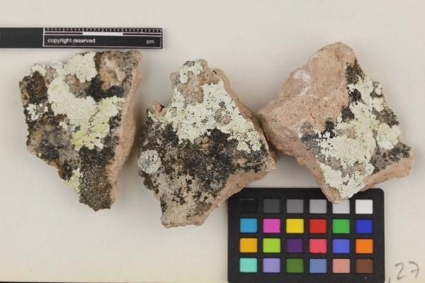
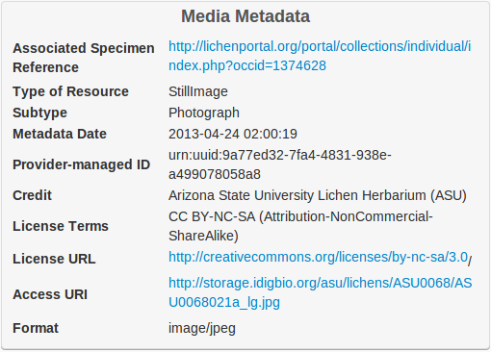
Audubon Core vocabularies address such concerns as:
- the management of the media and collections
- descriptions of their content
- their taxonomic, geographic, and temporal coverage
- appropriate ways to retrieve, attribute and reproduce them

Slide 15
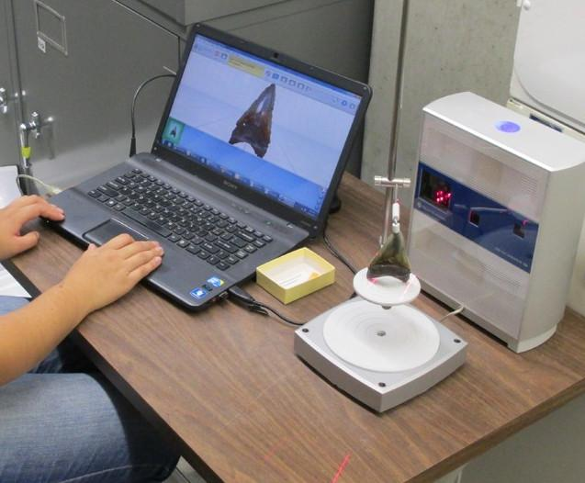
Audubon Core can support “new” media types
Specimen Data
dwc:catalogNumber: UF 105199
dwc:scientificName:
Carcharocles megalodon
dwc:stateProvince: Florida
dwc:county: Duval
dwc:latestPeriodOrHighestSystem:
Late Miocene
dwc:decimalLatitude: 30.39211
Media Data
dwc:scientificName:
Carcharocles megalodon
dc:type: image
ac:subtype: http://www.fabbers.com/StL.asp
ac:subtypeLiteral: 3dModel
ac:tag: tooth
Image source: Aaron Wood, Florida Museum of Natural History

Slide 16
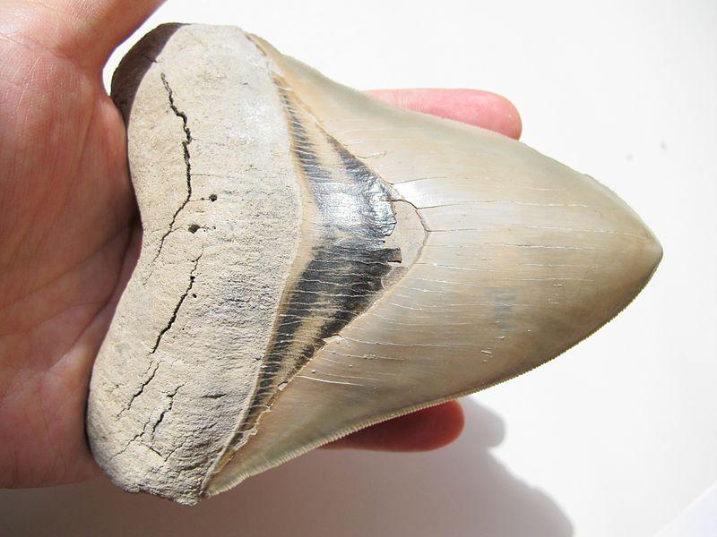
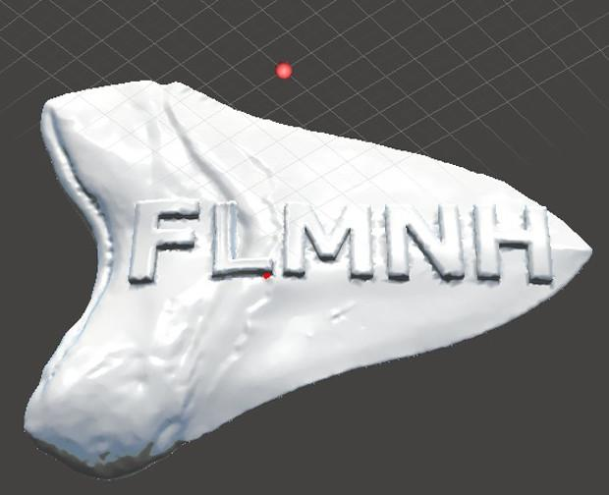
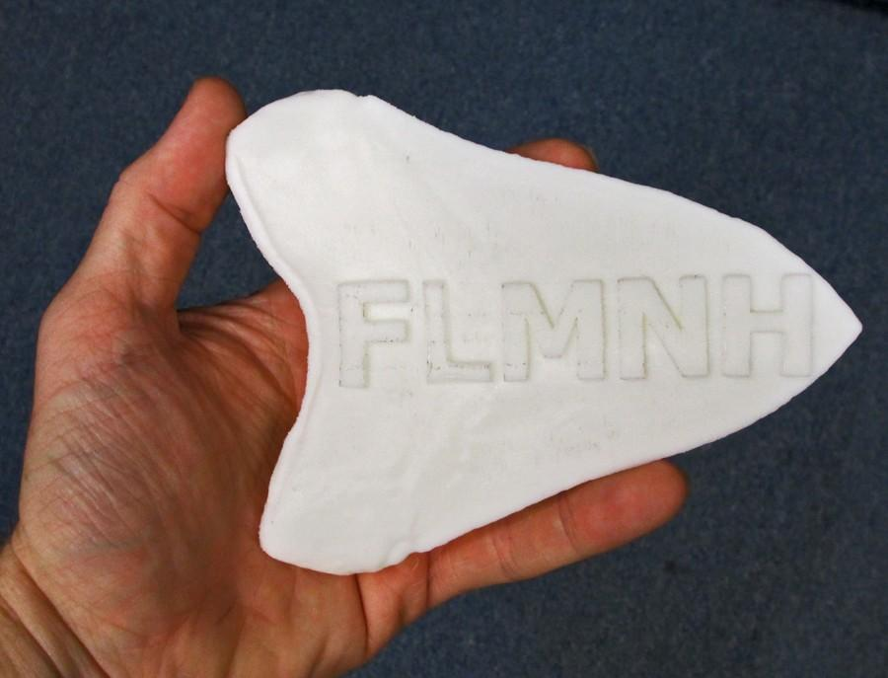
Image source: http://commons.wikimedia.org/wiki/File:Carcharocles_megalodon_tooth.JPG
Image source: Aaron Wood
Image source: Aaron Wood
3D Model printing by Robert Burns
Notes:
Here is a note

Slide 17
Recommended minimum Audubon Core fields for iDigBio Data Ingestion:
Access URI
Rights
Provider
Scientific name
Title
Description
Tags

Slide 18
Practical Details
Data Formats
ISO 8601 Dates
WGS84 Decimal Lat/Long
Controlled Vocabularies
ISO Country Names and Codes
State/Province names
Identifier Formats (UUID, ARK, URN, DOI, URI, URL, LSID, ...)
Copyright and Standard Licenses
Apple Core guidelines for herbaria
http://code.google.com/p/applecore/wiki/Introduction

Slide 19
Ingestion Process Changes Over the Past Year
New Staff (Dan Stoner… that’s me!)
Improved parallelization of ingestion tasks
Incremental Indexing
Database Tuning
Ingestion Reporting

Slide 20
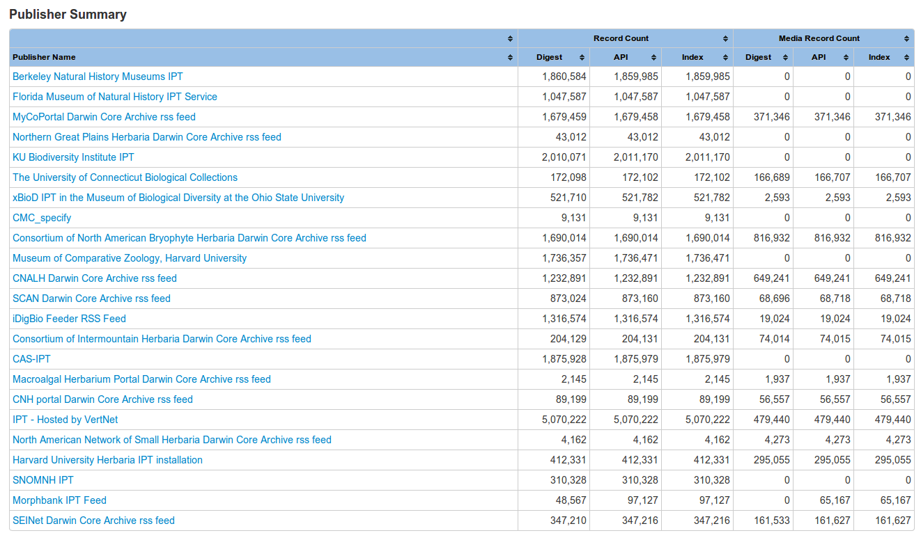
Ingestion Reporting
https://www.idigbio.org/portal/publishers

Slide 21
Planned Future Changes
Parallelize more parts of Ingestion process (such as media processing)
Support for additional publisher types (beyond IPT, Symbiota, iDigBio RSS Feeder)
Improved Ingestion logging and error detection
Support for additional media types (audio, 3D scans, …)
Data Quality

Slide 22
Thank You!

Slide 23
End.

